Slide 1
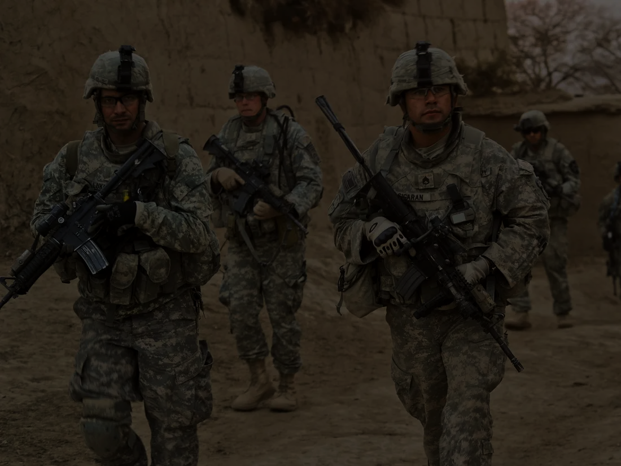
Soldiers Health Monitoring and Position Tracking System
By: Parithosh D Poojary (17BEC7050) (ECE - Core)
Prof: Dr.Suseela Vappangi

Slide 2
Introduction
In today’s era, enemy warfare is an important factor in any nation’s security. The national security mainly depends on Army, Navy and Air-Force. The important and vital role is played by the soldiers. As soon as any soldier enters the battlefield/warzone, it is very difficult for the army base station to know the location as well as the health status of all soldiers.
So, in order to obtain this crucial information about the soldier’s, who protect the nation, there should be some technology to protect them too. So, to support this technological idea, in this project I have come up with a system which will track soldiers as well as give their health status during the operation/mission.

Slide 3
Motivation
In today’s world, warfare is an important factor in any nation’s security. One of the important and vital role is played by the army soldiers. There are many concerns regarding the safety of soldiers. So for their security purpose, many instruments are mounted on them to view their health status as well as their real time location.
But because of network constraints considering the high altitudes or the harsh climatic conditions, there is always been a probability of losing the data.
Historical Background
Previously, predicting soldier work-rest cycles and training limits could only be addressed using generalized models based on estimated input about individuals and ambient conditions.
Thermal-work strain monitoring is one of the first military real time PSM (physiological status monitoring) application to be used outside of the research community but provides only one example of near term uses.
Notes:
PSM - physiological status monitoring.

Slide 4
Objective
To track the location and monitor the health of the soldier in real time, who get lost and injured in the battlefield, and also to minimize the time of search and rescue operation efforts of army control unit.
Application
The project can be implemented in battlefield or high altitude areas where health and location of soldiers is the most basic information which should be known to the control room.

Slide 5
Steps to Reach Goal
Information Gathering
Study of different areas along with existing problem statements.
Literature Survey
Gathering and studying of papers with in depth research on the topic.
Component Selection
Selection of components on the basis of the required specifications.
Analyse components
Analysis of all the selected components and in depth study of the components.
Designing
Designing of the model.
Simulation
Simulation of the project based on the first draft of the design.
Hardware Implementation
Implementing the whole project with hardware components.
Testing/Improvements
Testing of the designed hardware model, and if any improvements required adding it accordingly.
Final Implementation
Simulation of the whole project based on the final draft of the design.
Project Report Writing

Slide 6
Literature Survey
Hock Beng Lim, Di Ma, Bang Wang, Zbigniew Kalbarczyk, Ravishankar K. Iyer, Kenneth L. Watkin (2010); “A Soldier Health Monitoring System for Military Applications”.
P.S. Kurhe, S.S. Agrawal (2013); “Real Time Tracking and Health Monitoring System of Remote Soldier Using ARM 7”.
William Walker, A. L. Praveen Aroul, Dinesh Bhatia; “Mobile health monitoring system”.
Shweta Shelar, Nikhil Patil, Manish Jain, Sayali Chaudhari, Smita Hande; “Soldier Tracking And Health Monitoring Systems”.
Deepa J , Ranjini, Sharanya Raj , Dr.Parameshachai B D; “Soldier Health and Position Tracking System using GPS and GSM Modem”.
Shruti Nikam, Supriya Patil, Prajkta Powar, V.S.Bendre “Gps based soldiers tracking and health indication system”.

Slide 7
Components Required
Hardware
Arduino UNO
Temperature Sensor
ECG module
GPS module
Breadboard, Jumper cables
Battery (12V)
Wireless comm. Sensor
HC-12 sensor
LoRA WAN sensor
Software
Arduino IDE
Notes:
LoRA - sx1278
ECG8232
LM35
GPS - NEO6M

Slide 8
Wireless Communication Modules
HC – 12
HC-12 wireless serial port communication module is a new-generation multichannel embedded wireless data transmission module.
The HC-12 is a half-duplex 20 dBm transmitter paired with a receiver that has -117 dBm (2×10⁻¹⁵ W) sensitivity.
Paired with an external antenna, these transceivers are capable of communicating up to and possibly slightly beyond 1 km in the open and are more than adequate for providing coverage throughout a typical house.
Operating frequency range (433.4—473.0MHz).
LoRa WAN - (SX1278)
The term LoRa stands for Long Range.
The SX1278 transceivers feature the LoRa long range modem that provides ultra-long range spread spectrum communication and minimum current consumption.
This can achieve a distance of 15-20 km and can work on battery for years.
Advantages:
Long Range
Low Power consumption
Small size
Minimum cost for deployment.

Slide 9
Methodology

Slide 10
Methodology
This system enables GPS (Global positioning systems) tracking of these soldiers. It is possible by S-Health. The S-Health can be defined as mobile computing, medical sensors and communication technologies for health care. In this system, smart sensors such as (Temperature sensor, Heartbeat sensor, Pulse sensor, Wireless comm. sensor) are attached to the body of the soldiers in order to have their health status and their position in the warfield.
The hierarchy of obtaining data from the soldier is divided into three segments:
First Unit (Soldiers S-Health System)
Second Unit (Squadron/Group leader))
Third unit (Control room (Army base))

Slide 11
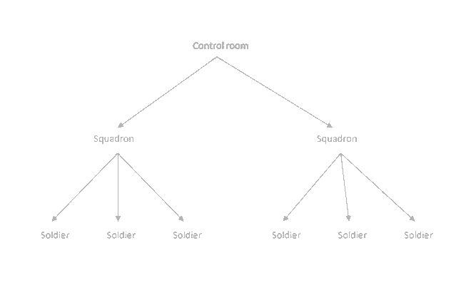
Network Architecture
Soldier (data of individual soldier) Squadron Leader (data of the individual soldier + data of the Squadron leader) Control Room

Slide 12
Block Diagram
12V Supply
Regulator
Temp sensor
HC-12
ECG module
Arduino UNO
LoRa WAN
GPS module

Slide 13
All the data collected from the S-Health system (of each individual soldier) is sent to the Squadron leader of the second unit via a wireless sensor module.
The same procedure is repeated and the data from the second unit (including the data of the each soldiers and the squadron leader) is sent to the third unit...i.e. Control Room, where it is all about collecting all the data at one place so if any soldier is in trouble then he/she can be tracked down and help can be sent for the individual.
* two different wireless communication devices used in the system. For the communication b/w the first and the second unit - a low range wireless communication device (≤1000 m) is used, whereas for the second and the third units communication - a long range wireless communication device(15-20 km) is used.

Slide 14
Timeline

Slide 15
Information Gathering
Study of different areas along with existing problem statements.
Component Selection
Selection of components on the basis of the required specifications.
Designing
Designing of the model.
13.08.2020
20.08.2020
03.09.2020
13.09.2020
24.09.2020
Literature Survey
Gathering and studying of papers with in depth research on the topic.
Analyse Components
Analysis of all the selected components and in depth study of the components.

Slide 16
Simulation
Simulation of the project based on the first draft of the design.
Testing/Improvements
Testing of the designed hardware model, and if any improvements required adding it accordingly.
Project Report Writing
Preparation of the final report for the capstone.
28.09.2020
03.10.2020
01.11.2020
15.11.2020
27.11.2020
Hardware Implementation
Implementing the whole project with hardware components.
Final Implementation
Simulation of the whole project based on the final draft of the design.

Slide 17
Thank You

